Slide 1
ASSIGNMENT 5
Physics of Data – Quantum Information and Computing
A.Y. 2024/2025
Lorenzo Calandra Buonaura
02/12/2024

Slide 2
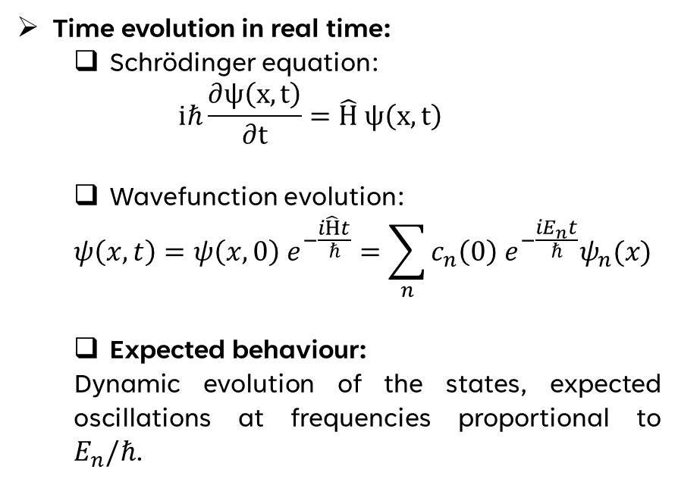

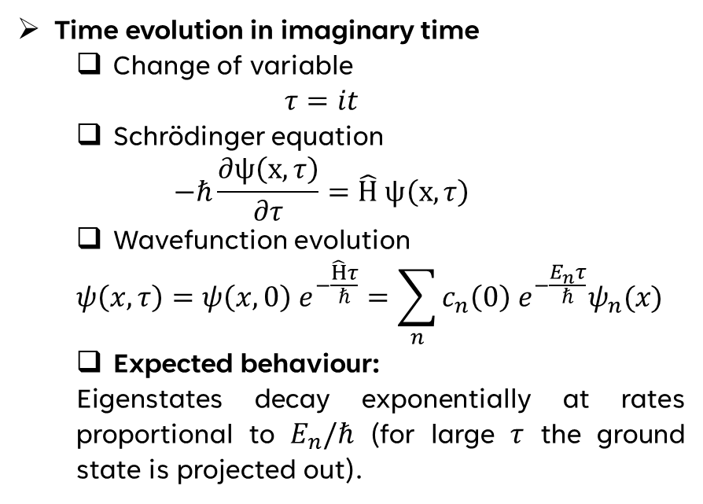
THEORY (1)
Time-dependent quantum harmonic oscillator
$$\hat{H}=\frac{{\hat{p}}^{2}}{2m}+\frac{ω^{2}}{2m}\left(\hat{q}−q_{0}(t)\right) with q_{0}\left(t\right)=\frac{t}{T} \left(t∈\left[0, T\right]\right)$$
Time evolution in real time:
Schrödinger equation:
$$iℏ\frac{∂ψ\left(x,t\right)}{∂t}=\hat{H} ψ\left(x,t\right)$$
Wavefunction evolution:
$$ψ\left(x,t\right)=ψ\left(x, 0\right) e^{−\frac{i\hat{H}t}{ℏ}}=\sum_{n}{{c_{n}\left(0\right) e}^{−\frac{iE_{n}t}{ℏ}}ψ_{n}(x)}$$
Expected behaviour:
Dynamic evolution of the states, expected oscillations at frequencies proportional to $E_{n}/ℏ$.
Time evolution in imaginary time
Change of variable
$$τ=it$$
Schrödinger equation
$$−ℏ\frac{∂ψ\left(x,τ\right)}{∂τ}=\hat{H} ψ\left(x,τ\right)$$
Wavefunction evolution
$$ψ\left(x,τ\right)=ψ\left(x, 0\right) e^{−\frac{\hat{H}τ}{ℏ}}=\sum_{n}{{c_{n}\left(0\right) e}^{−\frac{E_{n}τ}{ℏ}}ψ_{n}(x)}$$
Expected behaviour:
Eigenstates decay exponentially at rates proportional to $E_{n}/ℏ$ (for large $τ$ the ground state is projected out).

Slide 3
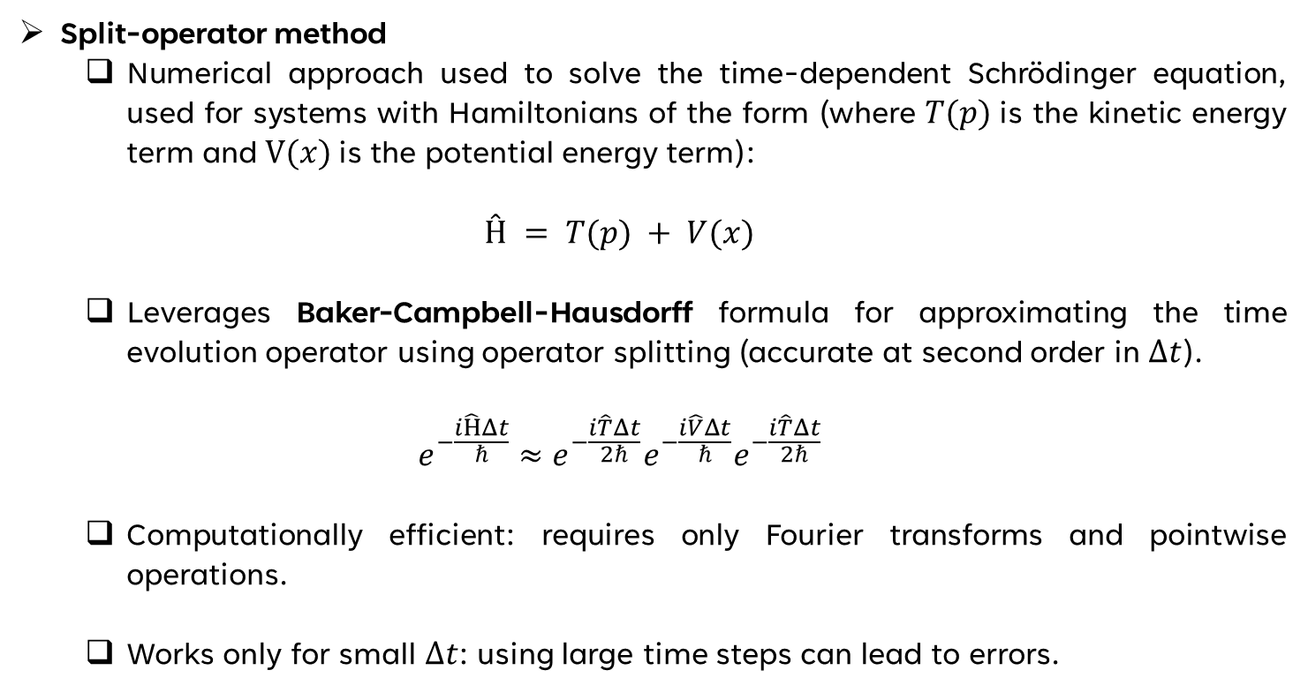
THEORY (2)
Split-operator method
Numerical approach used to solve the time-dependent Schrödinger equation, used for systems with Hamiltonians of the form (where $T(p)$is the kinetic energy term and $V(x)$is the potential energy term):
$$Ĥ = T(p) + V(x)$$
Leverages Baker-Campbell-Hausdorff formula for approximating the time evolution operator using operator splitting (accurate at second order in $Δt$).
$$e^{−\frac{i\hat{H}Δt}{ℏ}}≈e^{−\frac{i\hat{T}Δt}{2ℏ}}e^{−\frac{i\hat{V}Δt}{ℏ}}e^{−\frac{i\hat{T}Δt}{2ℏ}}$$
Computationally efficient: requires only Fourier transforms and pointwise operations.
Works only for small $Δt$: using large time steps can lead to errors.

Slide 4
CODE DEVELOPMENT (1)
class Operators:
"""
Container for holding operators and
wavefunction coefficients.
"""
def __init__(self,
res: int,
voffset: float = 0,
wfcoffset: float = 0,
omega: float = 1.0,
order: int = 2,
n: int = 0,
q0_func=None,
par: Param = None) -> None:
…
def _initialize_operators(self, par: Param,
voffset: float, wfcoffset: float,
order: int, n: int) -> None:
"""
_initialize_operators:
Initialize operators and wavefunction
based on the provided parameters.
…
def calculate_energy(self, par: Param) -> float:
"""
calculate_energy:
Calculate the energy <Psi|H|Psi>.
class Param:
"""
Param:
Container for holding all simulation
parameters.
"""
def __init__(self,
x_min: float,
x_max: float,
num_x: int,
tsim: float,
num_t: int,
im_time: bool = False) -> None:
…
def _validate(self) -> None:
"""
_validate :
Check for common errors in parameter
initialization.
"""
…

Slide 5
CODE DEVELOPMENT (2)
def split_op(par: Param, opr: Operators) -> None:
for i in range(par.num_t):
q0 = opr.q0_func(i * par.dt)
opr.V = 0.5 * (par.x - q0) ** 2 * opr.omega ** 2
# Evolution
coeff = 1 if par.im_time else 1j
opr.R = np.exp(-0.5 * opr.V * par.dt * coeff)
opr.wfc *= opr.R
opr.wfc = np.fft.fft(opr.wfc)
opr.wfc *= opr.K
opr.wfc = np.fft.ifft(opr.wfc)
opr.wfc *= opr.R
# Density for plotting and potential
density = np.abs(opr.wfc) ** 2
# Renormalization
if par.im_time:
renorm_factor = np.sum(density * par.dx)
if renorm_factor != 0.0:
opr.wfc /= np.sqrt(renorm_factor)
density = np.abs(opr.wfc) ** 2
else:
db.checkpoint(debug=True, msg1=f"RENORMALIZATION WARNING! …", stop=False)
# Saving for visualization (100 snapshots)
…

Slide 6
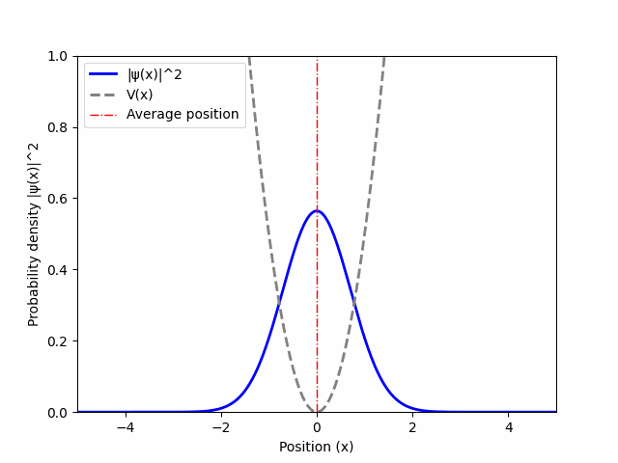
RESULTS (1)
Real time evolution (T = 6.44)
Imaginary time evolution (T = 6.44)

Slide 7
RESULTS (2)
Real time evolution (T = 17.33)
Imaginary time evolution (T = 17.33)

Slide 8
RESULTS (3)
Real time evolution (T = 106.05)
Imaginary time evolution (T = 106.05)

Slide 9
RESULTS (4)
Real time evolution (T = 421.21)
Imaginary time evolution (T = 421.21)

Slide 10
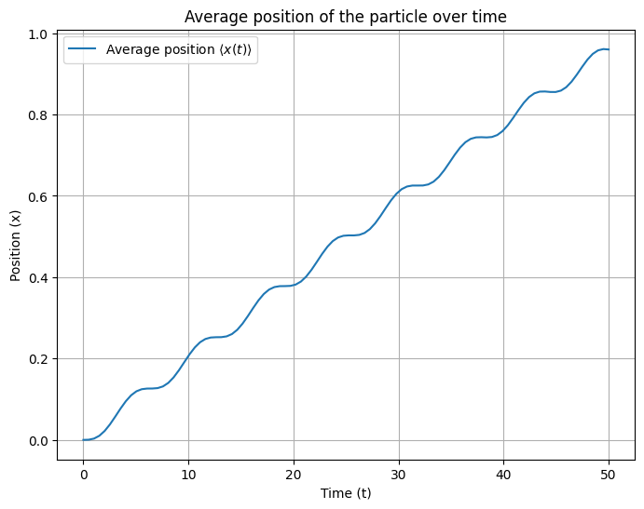
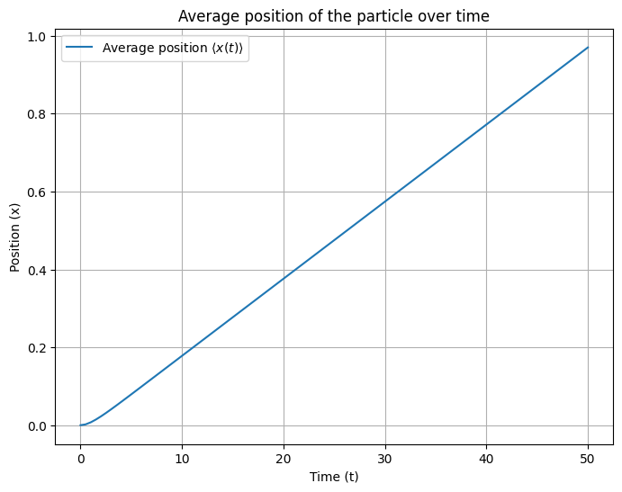
RESULTS (5)
Real time (T = 50.00)
Imaginary time (T = 50.00)

Slide 11
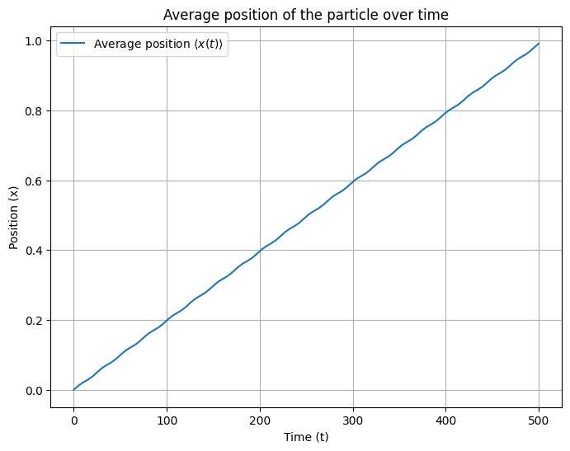

RESULTS (6)
Real time (T = 50.00)
Imaginary time (T = 50.00)

Slide 12
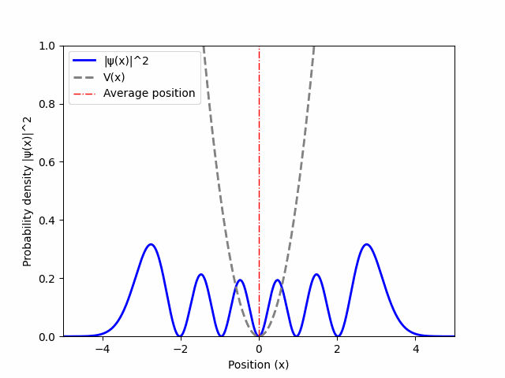
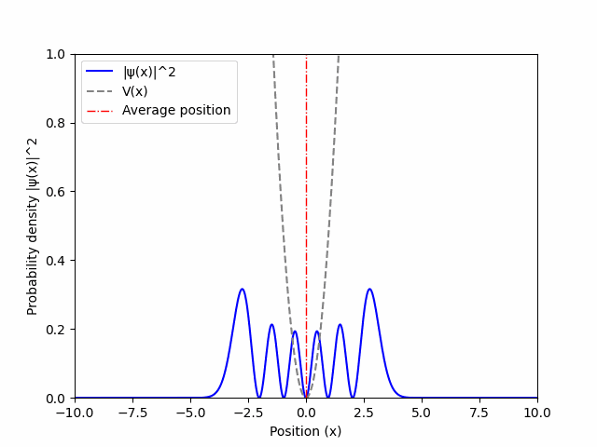
RESULTS (7)
Imaginary-time evolution
T = 421.21
Real time evolution (n = 5)
Imaginary time evolution (n = 5)

Slide 13
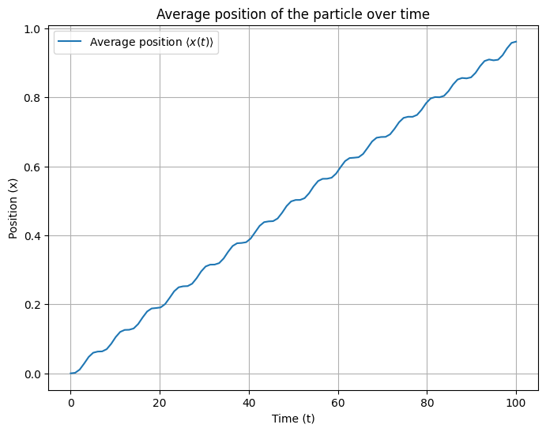
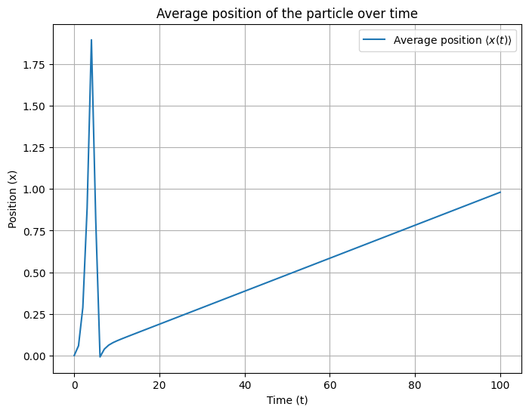
RESULTS (8)
Real time (n = 5)
Imaginary time (n = 5)

Slide 14
CONCLUSIONS
Real-Time Evolution:
Models physical dynamics, with oscillatory behavior governed by energy eigenvalues (‘dies’ in adiabatic limit).
Imaginary-Time Evolution:
Projects onto the ground state by exponential decay of higher-energy contributions (important for ground-state determination).
Split-Operator Method:
Efficiently handles both real and imaginary-time evolution, relying on operator splitting for accuracy and simplicity.

